Slide 1

High-Performances Dual M-Layers Avalanche Photodiodes from Single-Photon Detection to High Saturation Output Current
Speaker : Prof. Jin-Wei Shi
Coauthor: Prof. Queena Lee
Notes:
各位口試委員大家好，我是廖彥旻，我的指導教授是許晉偉教授，今天我要報告的題目是
用於光達系統擁有單光子偵測能力和高飽和電流特性的雙層累增層設計累增崩潰光二極體

Slide 2
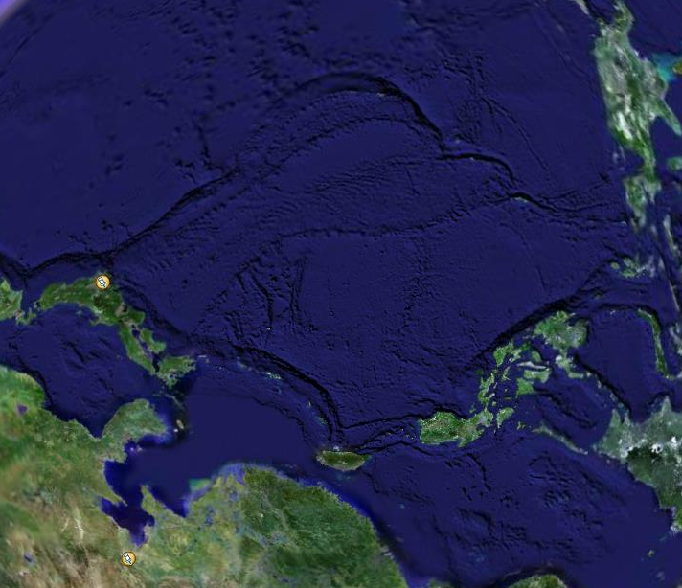
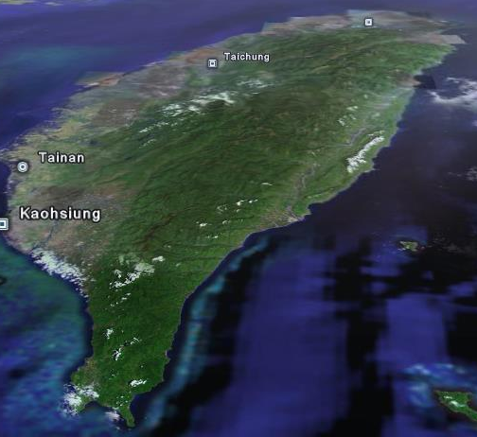
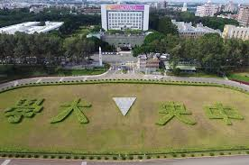
Where we
come from?
NCU Taiwan

Slide 3



Collaborators
微光電實驗室
Team :Prof. Queena Lee, Po-Shun Wang , Naseem, Zohauddin Ahmad
Notes:
目前就讀於中央大學電機工程學系，特別感謝國立中央大學微光電實驗室提供無塵室以及器材等供我實驗，也特別感施杰忱、Naseem、Zohauddin
的幾位學長協助我在實驗上大小事。也要感謝索爾思光電公司提供一些製程上的協助以及化學用品的提供，最後感謝李依珊老師實驗室協助我在元件上的量測工作

Slide 4

Outline
Introduction and Motivation
Previous Arts
Our demonstrated dual M-layer structure
Measurement Results
Conclusion

Slide 5
Outline
Introduction and Motivation
Previous Arts
Our demonstrated dual M-layer structure
Measurement Results
Conclusion

Slide 6
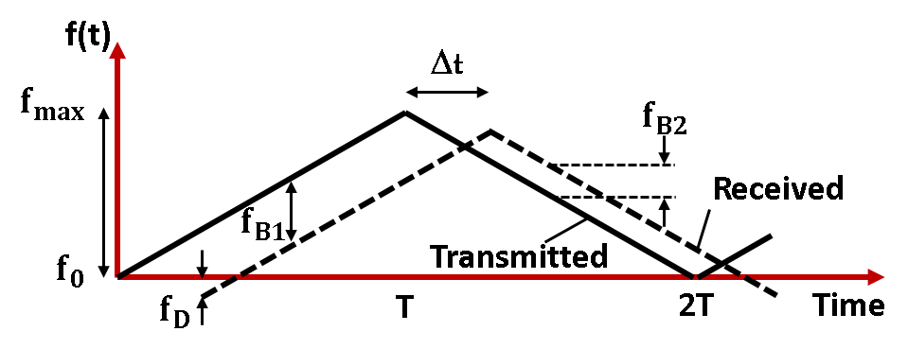
Two kinds of Lidars
Time of Flight
Coherent Detection (FMCW)
1550nm
Rejects in-coherent signal
Short noise limited detection
Eye safety concern at 905 nm
Difficult to achieve short noise limit
Sensitive to background
light/crosstalk
Direct-Detection
Fig. FMCW lidar architecture
Homodyne-Detection
Single-photon detection
B. Behroozpour et al “Chip-Scale Electro-Optical 3D FMCW Lidar with 8μm Ranging Precision,” ISSCC Dig. Tech. Papers, San Francisco, CA, USA, pp. 214-215, Feb. 2016.
Use strong LO power to enhance S/N thus need high saturation power APD!

Slide 7
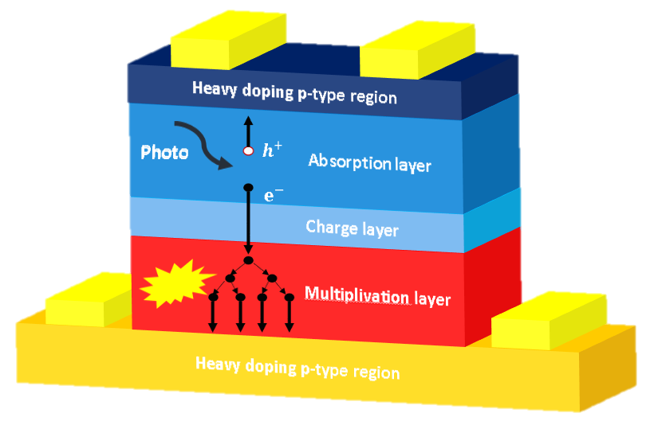
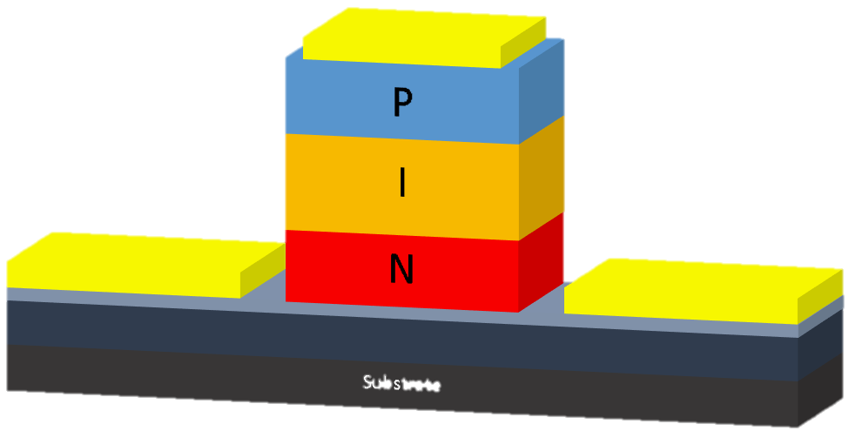
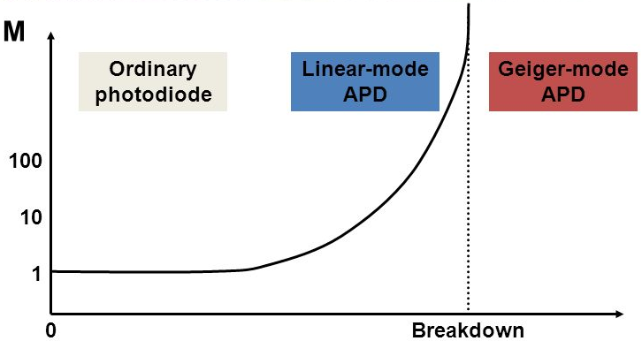
What Kind of Receiver we need?
Time of Flight
Coherent Detection
Avalanche photodiodes operated under Geiger mode for single-photon detection
P-I-N photodiodes with high-responsivity and high saturation power (under strong LO pumping)…
7
Notes:
我們比較TOF LIDAR系統與 Coherent LIDAR系統兩者接收端元件的比較
TOF LIDAR技術的接收端元件使用操作於Geiger mode 的單光子雪崩光二極體
Coherent LIDAR系統則使用擁有高頻寬，高響應度，高飽和功率的PINPD
而我們所要展示的Coherent LIDAR系統則是操作在線性區域的APD元件

Slide 8
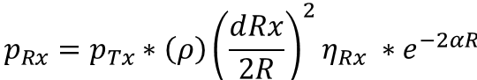
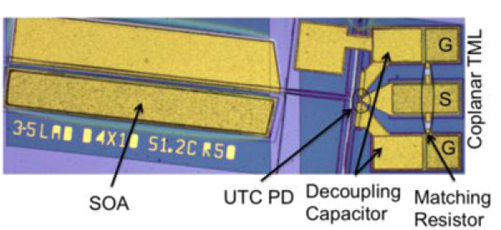
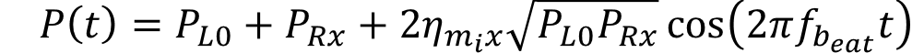
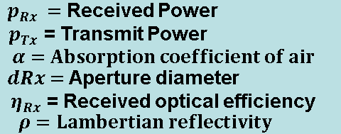
What Kind of Receiver we need in FMCW?
General photon budget for scattered at distance R :
High RES and High-Power PD
Strong optical LO source
Aperture size of waveguide type SOA UTC is usually too small to capture the weak reflection light from object
1.p-i-n PD no Gain
2. Limited optical LO power from PIC lidar (< 10 mW)
High optical LO power is desired
Coherent detection
How about a high-power APD at linear mode (moderate gain) with top-illuminated structure ?
8
Notes:
在這個Coherent偵測的公式中，可以看到，我們將高工率DFB的功率用於傳輸功率以及局部震盪器的驅動
如果我們想獲得更高的偵測功率，我們可以增加光接收效率，如此一來，我們可以將DFB大部分的功率用來驅動局部震盪器

Slide 9
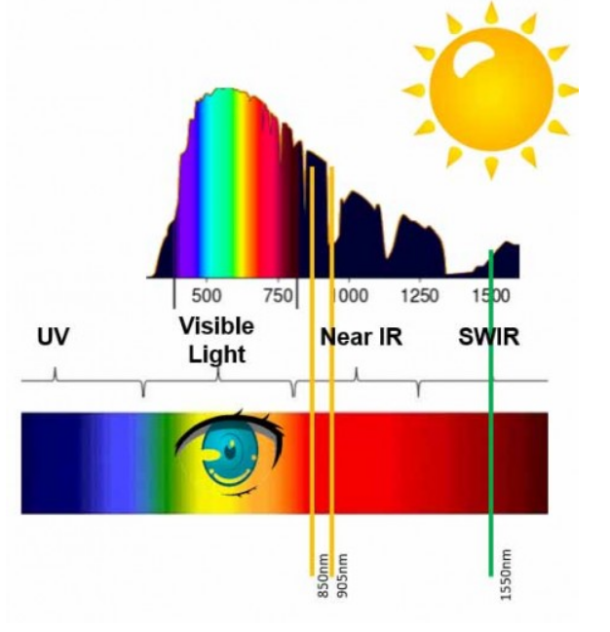
Operating wavelength in free-space
Why 1550nm ?
Visible and Near-Infrared wavelengths can be focused by the eye
A far better wavelength is 1550nm :
eye safety
Limitation for ToF lidar application
https://www.novuslight.com/fmcw-the-future-of-lidar_N9691.html
Notes:
在一般光達應用中，光會在自由空間中傳輸，對於自由空間傳輸的光來說，應用上通常我們會把操作撥波段推到1550，因為在自由空間傳播的光，人眼安全是一個很重要的需要考量的因素。而可見光和近紅外光光譜，可被人眼所聚焦，進而被視網膜吸收，對人體會造成危害，因此我們會去規範最大可操作的功率，這對操作在905nm波段的ToF光達系統來說是一個很大的問題，因為其限制了它的偵測範圍。因此我們會希望我們在自由空間傳播的光操作在短波紅外線波段，尤其是1550nm，其可以避免視網膜的吸收，人眼安全性相對高，同時也可以使用相對成熟的光通信元件去實現我們的光達系統

Slide 10
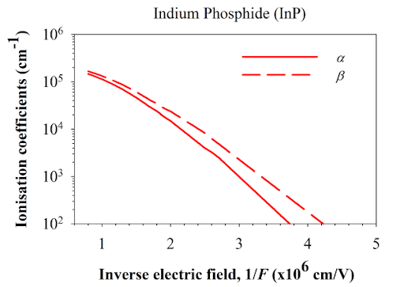
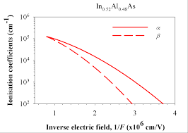
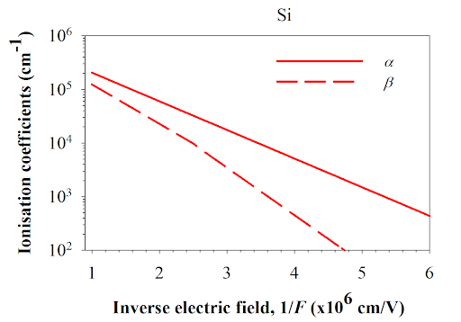
Si based SPAD limitation
K value larger
Limitation for application in telecommunication wavelength(1310nm & 1550nm)
Bottleneck :
Bandgap Limitation
InGaAs /InP SACM APD was reported
Disadvantage of III-V Compound:
More defect (Afterpulsing effect Serious)
Poor impact ionization property
Dual M-layer Design
was proposed
Dark count rate(DCR)↑
InP & InAlAs material quality poor than Si (Afterpulsing effect)
K value smaller
M-layer thickness decreases
http://impact-ionisation.group.shef.ac.uk/ionisation_coeff/Si/ http://impact-ionisation.group.shef.ac.uk/ionisation_coeff/InP/
http://impact-ionisation.group.shef.ac.uk/ionisation_coeff/InAlAs/
Notes:
傳統上用以矽為基底的單光子偵測器，其擁有高的偵測效率和低的暗計數率，但是矽的能隙限制了我們元件的操作波長小於1.1um，而現今的量子通訊.光纖通訊等等的操作波長大概落在1.55或1.31um附近，使我們無法運用這些光偵測器在這些應用上，因此焦點開始轉向InP/InGaAs SACM APD，並試圖改良其特性，讓我們可以運在現今的光通信領域或光達系統中，但是跟矽相比材料擁有較多缺陷，Afterpulsing的現象較嚴重，同時我們可以看到右圖，InP/InAlAs的k值較大，有較差的崩潰特性。因此通常比較簡單的解決方法就是講壘曾層的厚度縮薄，來降低三五族半導體材料中缺陷所帶來的影響，但是有可能造成暗技術的上升與偵測效率的下降。因此我們提出了一個雙層壘曾層的結構以克服直接縮博壘曾層所帶來之劣勢

Slide 11
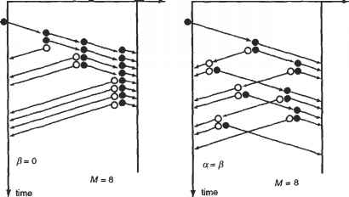
Bottleneck of conventional APD
Saturation current of the APD is usually much smaller than that of the p-i-n PD under strong light pumping due to avalanche process (Increase of effective D-layer thickness)
Saturation current can be improved, but it increases the dark count rate(DCR) in Geiger mode operation
Complex avalanche process: Effective D increases !!
Dual M-layer Design
was proposed
This impedes its application in coherent detection(FMCW)
Saturation current : J_{max} ≈ (V_{bias}+ø)ε V_{carriers} / D²
M-layer thickness decreases
(Reduce (D-layer) avalanche delay time)
Notes:
投影片下方為光感測器元件的飽和電流公式，其中D為空乏區寬度，V_{carriers}為載子的移動速度，由於受制於雪崩的影響，讓APD相較於PIN二題體載子移動速度較慢，透過公式我們可以發現，其會造成飽和電流下降，因此APD相較於P-I-N光偵測器擁有較低的飽和電流，這也是為甚麼現在的FMCW光達系統主要還是以P-I-N光偵器做為接收端元件。因此，我們希望透過累增層縮薄的方式，降低載子的累曾延遲時間，提升元件在在線性模式操作下的飽和電流，但是這樣做會造成累增層中穿隧電流的上升，讓元件在蓋格模式操作下暗計數的上升，造成在單光子偵測上的阻礙，因此我們希望透過雙層壘曾層的設計去解決這樣的trade off

Slide 12

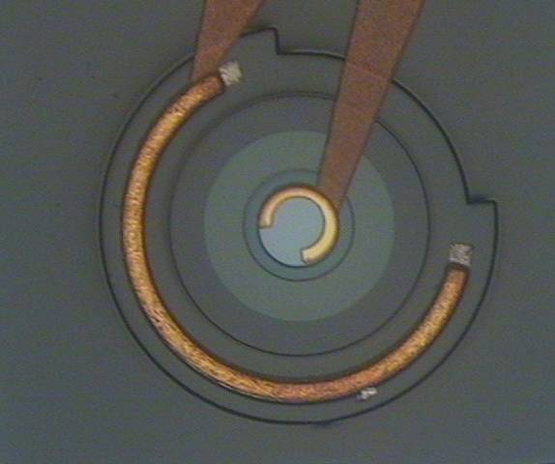
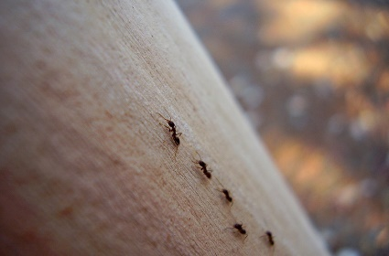
Highlight of our APD
Strong Light
Linear mode
RF power with a 6.3 A/W responsivity can be as high as +6.95 dBm at a high 7 mA output photocurrent
Our APD
FMCW Lidar system
Weak Light
SPDE 61.4% at the gating frequency of 10 kHz for 200 K
ToF Lidar system
Single photon detection
Geiger mode
https://daddypoppy.pixnet.net/blog/post/223454817-%E8%B1%A1
single photon avalanche photodiode (SPAD)
Notes:
那在FMCW光達系統中，在接收端我們用一個很強的LO去 pumping，把從物體反射回來的弱光做放大，因此元件需要在高功率下做操作，而藉由實驗發現我們的元件在7mA(響應度為6.3A/W)的高輸出電流下，可以擁有6.95dbm的RF輸出功率，期高功率的特性，讓我們可以在FMCW光達系統中有一個很好的應用。
在ToF光達系統中，我們利用元件極高的增益和高偵測效率，直接對物體反射回來的弱光作偵測，藉由實驗發現，我們在10KHz的閘控頻率與200K的溫度操作下的元件可以擁有61.4%的單光子偵測效率，讓我們的元件可應用於單光子偵測和ToF光達系統的領域中。

Slide 13
Outline
Introduction and Motivation
Previous Arts
Our demonstrated dual M-layer structure
Measurement Results
Conclusion

Slide 14
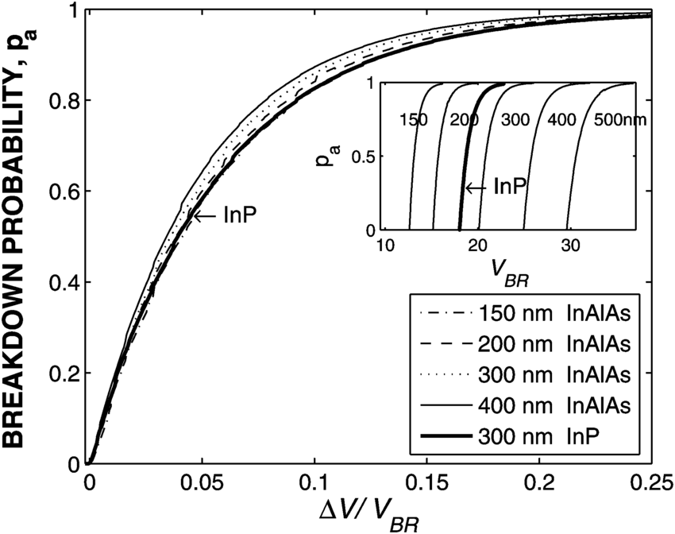
InAlAs vs. InP based SAPDs
Advantage of InAlAs over InP :
Temperature stability
Higher avalanche breakdown probability (larger bandgap; less tunneling)
larger difference between the electron and hole ionization coefficients
Dark count rate(DCR)↑
M-layer thickness decreases
Material quality InAlAs versus InP??
Afterpulsing effect(DCR)
https://www.researchgate.net/figure/Calculated-injected-carrier-breakdown-probability-for-In-Al-As-as-a-function-of-the_fig1_2974791 Ramirez, David & Hayat, Majeed & Karve, Gauri & Campbell, Joe & Torres, Sergio & Saleh, Bahaa & Teich, Malvin, " Detection Efficiencies and Generalized Breakdown Probabilities for Nanosecond-Gated Near Infrared Single-Photon Avalanche Photodiodes, " , March 2006.
Notes:
隨著時間眼間演進，許多實驗室提出以InAlAs代替InP成為累增層的材料，其提供了以下優點，第一:它擁有更好的溫度穩定性，它的崩潰電壓相較之下不會隨著溫度而劇烈變動，這讓我們再操作元件時能夠更彈性。第二它擁有更高的崩潰機率，同時亦代表著它會有更好的偵測效率，其崩潰機率隨著超額偏壓的上升，會增加得更快速。第三: 它電子和電動的離子化係數差比較多，擁有較好的電離特性，而由於在磊晶成長的過程中，InAlAs為三元材料，InP為二元材料，因此InAlAs的材料品質相較於InP沒這麼好，期會造成後脈衝效應之劣化，因此我們會希望將壘曾層縮博來抑制這個現象，而如同先前討論，此舉會讓暗計數上升，影響元件在Geiger mode的操作。

Slide 15
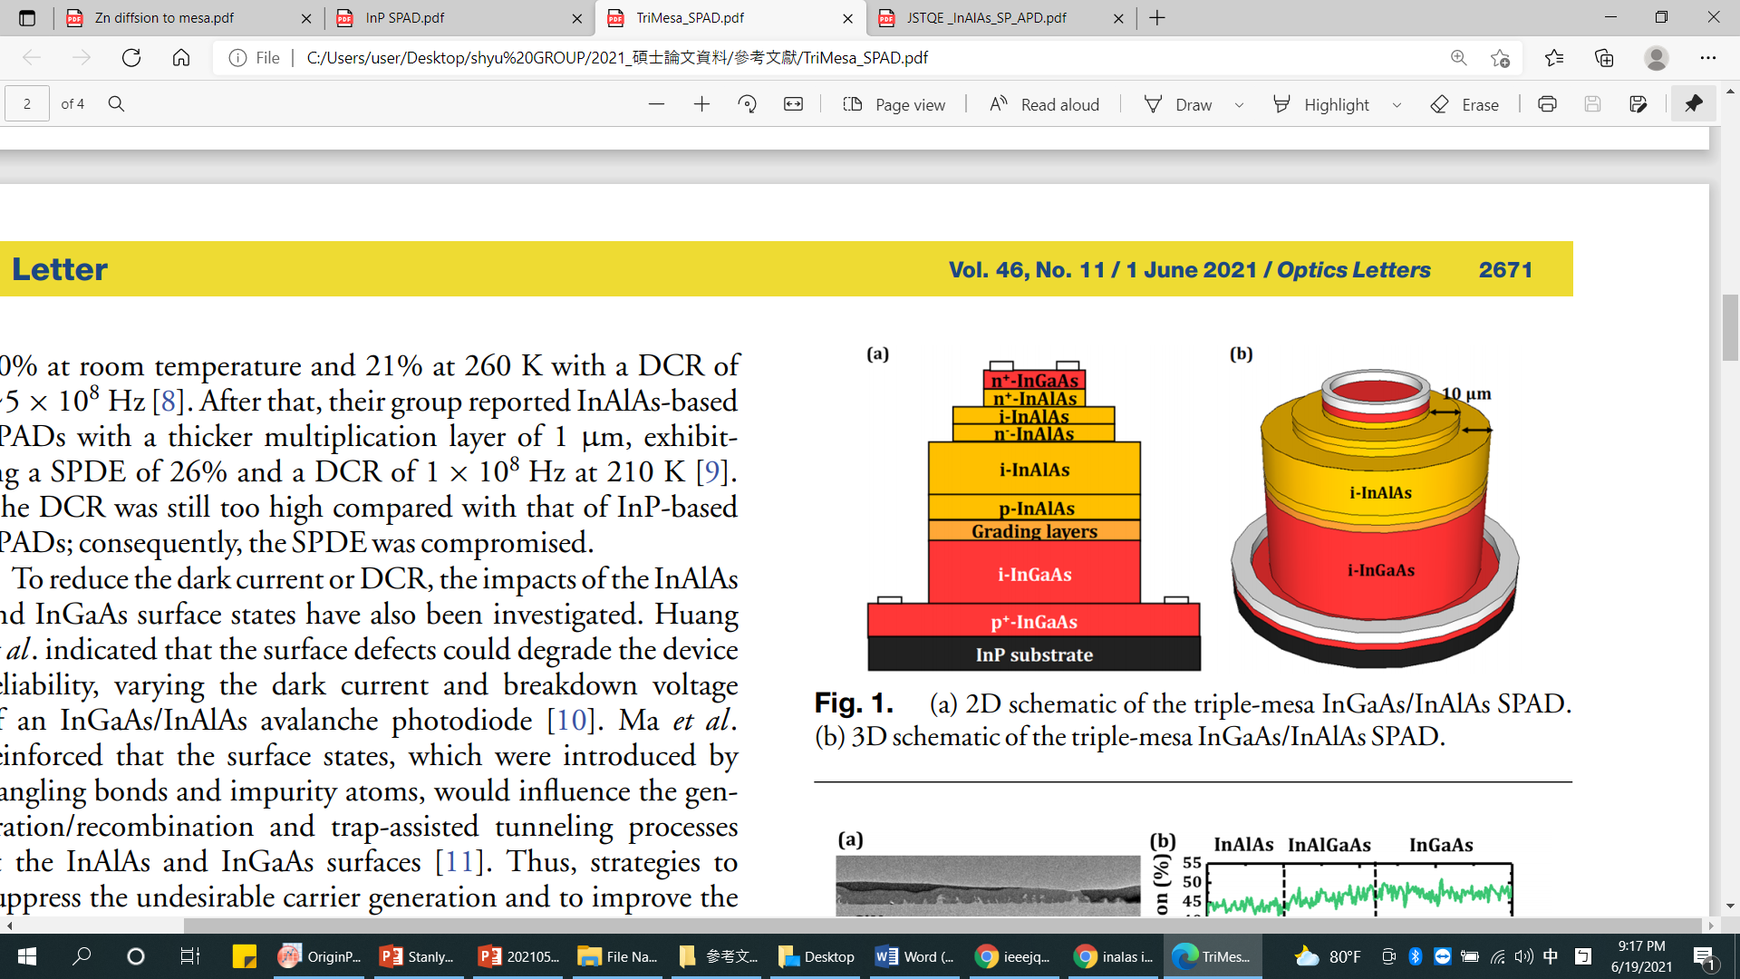
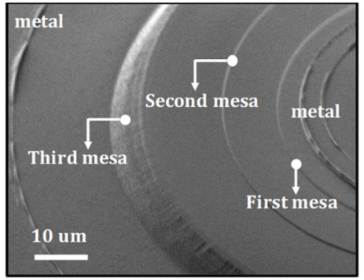
InAlAs based SPAD
Use InAlAs for multiplication layer
Use InGaAs for Absorption layer
Mesa Structure : 1.Supress surface leakage and premature breakdown
2.Reduce Dark count rate(DCR)
3.Better Vbr uniformity than Zn-diffusion type
Jishen Zhang, Haibo Wang, Gong Zhang, Kian Hua Tan, Satrio Wicaksono, Haiwen Xu, Chao Wang, Yue Chen, Yan Liang, Charles Ci Wen Lim, Soon-Fatt Yoon, and Xiao Gong, "High-performance InGaAs/InAlAs single-photon avalanche diode with a triple-mesa structure for near-infrared photon detection," Opt. Lett. 46, 2670-2673,2021
Notes:
此結構為2021年被提出之蝕刻平台型元件，利用2um窄能隙的InGaAs作為吸收層，以確保高的吸收效率，同時用1um厚的InAlAs做為壘曾層，確保高的崩潰機率，當元件可操作在240K，可以達到35%的單光子偵測效率。此元件利用蝕刻平台去將電場侷限在元件中心，有助於降低表面漏電流與抑制邊緣崩潰，進而降低暗計數，其相較於鋅擴散的結構較好掌控，有助於日後在陣列上的應用或是高精密度的設計。

Slide 16
Epitaxy Design concern in Mesa Structure
Multiplication layer exposes to the air
Can we have strong
E-field confinement with
M-layer in the bottom of epi ?
Surface breakdown becomes problem
Jishen Zhang, Haibo Wang, Gong Zhang, Kian Hua Tan, Satrio Wicaksono, Haiwen Xu, Chao Wang, Yue Chen, Yan Liang, Charles Ci Wen Lim, Soon-Fatt Yoon, and Xiao Gong, "High-performance InGaAs/InAlAs single-photon avalanche diode with a triple-mesa structure for near-infrared photon detection," Opt. Lett. 46, 2670-2673,2021
Notes:
通常為了使用蝕刻平台去侷限電場，我們將累增層則設計在磊晶結構的上方靠近N極的地方，並利用蝕刻圓柱去得到更好的電場場型分布，盡量把電場侷限於元件的中心。但其實這樣的結構會將高電場的累增層曝露在空氣中，很可能會有表面崩潰的問題。因此我們在思考，是否可以將壘曾層放在下面，並同樣用蝕刻平台去侷限電場。

Slide 17
Outline
Introduction and Motivation
Previous Arts
Our demonstrated dual M-layer structure
Measurement Results
Conclusion

Slide 18





Dual M-layer design
P+ Contact (In_{0.53}Ga_{0.47}As)
$$M_{1}$$
P+ Window (In_{0.53}Ga_{0.47}As)
$$M_{2}$$
P Graded Band(InAlGaAs)
i Absorber (In_{0.53}Ga_{0.47}As)
i Graded Band (InAlGaAs)
Avalanche only happens in second M-layer.We effectively constrains the multiplication process to a thin high-field region rather than the whole thick M-layer
→ suppress afterpulsing
smaller jitter
higher saturation current
P Field Control (In_{0.52}Al_{0.48}As)
i Multiplication (In_{0.52}Al_{0.48}As)
P Field Control (In_{0.52}Al_{0.48}As)
We can keep thick thickness of M-layer
,indicating reduction in tunneling effect.
→ DCR decreases
i Multiplication (In_{0.52}Al_{0.48}As)
N Contact (In_{0.52}Al_{0.48}As)
N+ Contact(InP)
The electrons transit to the second 300 nm thick M-layer for the initiation of impact ionization
S.I.InP Substrate
$$M_{2}$$
$$M_{1}$$
This can avoid the $M_{2}$ being pushed into the deep avalanche region for very high-gain operation
It has not reached the threshold of impact ionization, will energize and accelerate the carriers to the bottom multiplication layer
Notes:
我們提出雙層累增層的結構。我們將累增層拆成兩層，第一層累增層厚度為200nm，第二層累增層厚度為300nm，並在其中間加入一層P摻雜的電場控制層，去進一步控制兩層累增層的電場分佈。當光生電子被內建電場掃入第一層累增層後，會被電場加速並累積能量，但是其電場又不足以讓載子發生撞擊游離化，因此載子會繼續被加速移動到第二層累增層，藉由第二層累增層的高電場觸發撞擊游離化的機制，進一步發生累增崩潰，我們藉由調整電場控制層的濃度，可以得到階梯狀的場型分佈，進而去控制累增崩潰發生的區域，這個方法可以讓trap在高電場區的數量下降，有效降低後脈衝效應，並且降低載子的累增延遲時間，進而提升元件的飽和電流與時基誤差，同時藉由維持了整個壘曾層的厚度進而抑制因為累增層縮薄所帶來的穿隧電流。在高增益操作時，M1的電場會變很大，此時M1和M2都會對增益做出貢獻，因此讓我們的增益變很大，因此在這樣的設計中，我們不須將M2推到很深的崩潰，因此頻寬的劣化會趨緩

Slide 19
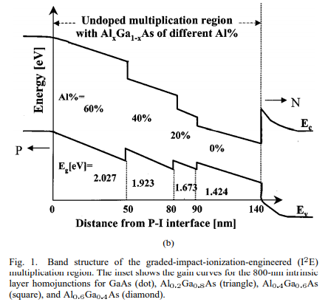
Comparison with I²E Structure
APD involves utilization of materials with different bandgap in multiplication region
(Only breakdown in narrow bandgap material)
S. Wang et al., "Low-noise avalanche photodiodes with graded impact-ionization-engineered multiplication region," in IEEE Photonics Technology Letters, vol. 13, no. 12, pp. 1346-1348, Dec 2001.
Notes:
除了階梯狀的場型分佈設計之外，在這邊我們回顧一篇I²E(impact-ionization-engineered multiplication)的結構，它利用將累增層的切成好幾層，並調控每層之能隙，讓累增層形成漸變能隙(graded bandgap)的結構，而在這樣的結構中，我們可以控制崩潰只發生於窄能隙的材料中，而不是讓整個累增層崩潰，其結構如圖所示， 由此可知，當窄能隙的累增層發生崩潰時，所產生之電洞，在移動過程，隨著能隙變大，所需發生撞擊電離的閾值能量(impact-ionization threshold energy)也會越大變大，除了抑制電洞所觸發之崩潰，亦造成電洞傳輸上的困難，因而讓電子主導整個崩潰的機制，進而降低累增效應所帶來之雜訊(noise)。但是這樣的結構同時也會讓增益頻寬積(GBP)下降，同時，窄能隙材料的使用亦會讓暗電流上升。鑒於以上缺點，我們希望還是透過調變電場控制層的參雜濃度去得到階梯狀的電場，進而控制累增崩潰發生之區域

Slide 20
Epi structure
Better localization of impact ionization
,thus reduce the avalanche delay time
Vertical Electric Field Distribution
P+ Contact (In_{0.53}Ga_{0.47}As)
100nm
P+ Window (In_{0.53}Ga_{0.47}As)
300nm
P Graded Band(InAlGaAs)
40nm
i Absorber (In_{0.53}Ga_{0.47}As)
2000nm
i Graded Band (InAlGaAs)
40nm
P Field Control (In_{0.52}Al_{0.48}As)
30nm
i Multiplication (In_{0.52}Al_{0.48}As)
200nm
P Field Control (In_{0.52}Al_{0.48}As)
30nm
i Multiplication (In_{0.52}Al_{0.48}As)
300nm
N Contact (In_{0.52}Al_{0.48}As)
100nm
N+ Contact(InP)
1000nm
S.I.InP Substrate
Sufficient low to prevent tunneling in Absorption layer
Notes:
我們可以看到在崩潰電下的縱向電場分布，吸收層的電場被壓在51kv/cm，低於其臨界電場(180)，有效抑制穿隧的現象在吸收層發生。並且藉由電場控制層的參雜設計去調控兩層累增層的電場分布，我們可以有效控制雪崩僅發生在第二層壘增層，可有效降低壘增延遲時間。

Slide 21
Epi structure
The first and second mesa can effectively confine the strong E-field in the M-layer within the range of 240 μm diameter
120μm
P+ Contact (In_{0.53}Ga_{0.47}As)
P+ Window (In_{0.53}Ga_{0.47}As)
240μm
P Graded Band(InAlGaAs)
i Absorber (In_{0.53}Ga_{0.47}As)
i Graded Band (InAlGaAs)
h
300μm
P Field Control (In_{0.52}Al_{0.48}As)
h
i Multiplication (In_{0.52}Al_{0.48}As)
P Field Control (In_{0.52}Al_{0.48}As)
i Multiplication (In_{0.52}Al_{0.48}As)
N Contact (In_{0.52}Al_{0.48}As)
N+ Contact(InP)
S.I.InP Substrate
Notes:
這是我們提出的元件完成後的結構，第一個圓柱直徑有240um，第一個圓柱直徑有480um，第三個圓柱直徑則是600 um裡面包含著下面的電荷層(Charge layer)和累增層，我們期望藉由上面兩個mesa，可以把有效地把強烈電場侷限在累增層中心，由圖顯示，我們可以清楚看見在累增層的橫向電場分布，在累增層中心的電場可以高達到805kV/cm，而在累增層的邊緣，電場可以有效地被侷限在直徑480um的圓柱，而邊緣電場則在120kV/cm左右，有效抑制邊緣崩潰並有低的暗電流。並且將發生崩潰的累增曾設計在磊晶的下方來防止表面崩潰。

Slide 22
Outline
Introduction and Motivation
Previous Arts
Our demonstrated dual M-layer structure
Measurement Results
Conclusion

Slide 23
E field confinement
quadruple mesa structure
Tri-mesa structure
P+ Contact (In_{0.53}Ga_{0.47}As)
120um
P+ Contact (In_{0.53}Ga_{0.47}As)
120um
P+ Window (In_{0.53}Ga_{0.47}As)
P+ Window (In_{0.53}Ga_{0.47}As)
P Graded Band(InAlGaAs)
240um
P Graded Band(InAlGaAs)
240um
i Absorber (In_{0.53}Ga_{0.47}As)
i Absorber (In_{0.53}Ga_{0.47}As)
i Graded Band (InAlGaAs)
i Graded Band (InAlGaAs)
P Field Control (In_{0.52}Al_{0.48}As)
300um
P Field Control (In_{0.52}Al_{0.48}As)
i Multiplication (In_{0.52}Al_{0.48}As)
i Multiplication (In_{0.52}Al_{0.48}As)
P Field Control (In_{0.52}Al_{0.48}As)
P Field Control (In_{0.52}Al_{0.48}As)
i Multiplication (In_{0.52}Al_{0.48}As)
i Multiplication (In_{0.52}Al_{0.48}As)
N Contact (In_{0.52}Al_{0.48}As)
N Contact (In_{0.52}Al_{0.48}As)
N+ Contact(InP)
N+ Contact(InP)
S.I.InP Substrate
S.I.InP Substrate
Better E-field confinement in quadruple mesa structure

Slide 24
P+ Contact (In_{0.53}Ga_{0.47}As)
120um
P+ Contact (In_{0.53}Ga_{0.47}As)
120um
P+ Window (In_{0.53}Ga_{0.47}As)
P+ Window (In_{0.53}Ga_{0.47}As)
P Graded Band(InAlGaAs)
240um
P Graded Band(InAlGaAs)
240um
i Absorber (In_{0.53}Ga_{0.47}As)
i Absorber (In_{0.53}Ga_{0.47}As)
i Graded Band (InAlGaAs)
i Graded Band (InAlGaAs)
P Field Control (In_{0.52}Al_{0.48}As)
300um
P Field Control (In_{0.52}Al_{0.48}As)
i Multiplication (In_{0.52}Al_{0.48}As)
i Multiplication (In_{0.52}Al_{0.48}As)
P Field Control (In_{0.52}Al_{0.48}As)
P Field Control (In_{0.52}Al_{0.48}As)
i Multiplication (In_{0.52}Al_{0.48}As)
i Multiplication (In_{0.52}Al_{0.48}As)
N Contact (In_{0.52}Al_{0.48}As)
N Contact (In_{0.52}Al_{0.48}As)
N+ Contact(InP)
N+ Contact(InP)
S.I.InP Substrate
S.I.InP Substrate
Device A
Device B
Notes:
我們將此次展示的結構A與過去展示的結構B進行比較，兩者的差異在於多一道mesa的不同，期望藉由更好的電場侷限，使元件獲得更良好的特性。

Slide 25



I-V curve
100% collection efficiency & 0% coupling loss
$(1−e^{\left(−(2×0.8)\right)}$) $×\frac{1.55}{1.24}≅0.997A/W$
$V_{br}$=51.2
$V_{br}$=43.2
P+ Contact (In_{0.53}Ga_{0.47}As)
P+ Contact (In_{0.53}Ga_{0.47}As)
P+ Window (In_{0.53}Ga_{0.47}As)
P+ Window (In_{0.53}Ga_{0.47}As)
P Graded Band(InAlGaAs)
P Graded Band(InAlGaAs)
The smaller dark current and larger V_{br} of device A can be attributed to suppression of the edge breakdown due to its additional mesa structure
i Absorber (In_{0.53}Ga_{0.47}As)
i Absorber (In_{0.53}Ga_{0.47}As)
i Graded Band (InAlGaAs)
i Graded Band (InAlGaAs)
P Field Control (In_{0.52}Al_{0.48}As)
P Field Control (In_{0.52}Al_{0.48}As)
i Multiplication (In_{0.52}Al_{0.48}As)
Space charge screening effect (Gain ↓)
i Multiplication (In_{0.52}Al_{0.48}As)
P Field Control (In_{0.52}Al_{0.48}As)
P Field Control (In_{0.52}Al_{0.48}As)
i Multiplication (In_{0.52}Al_{0.48}As)
i Multiplication (In_{0.52}Al_{0.48}As)
N Contact (In_{0.52}Al_{0.48}As)
N Contact (In_{0.52}Al_{0.48}As)
N+ Contact(InP)
N+ Contact(InP)
S.I.InP Substrate
S.I.InP Substrate
Notes:
圖分別顯示了A元件和B元件在1.31mm的光波長下受到不同光功率照射的光電流、暗電流隨偏壓的變化。兩個元件在結構上具有相同的累增層設計以及相同的電荷層濃度摻雜，我們可以發現punch電壓都大概落在24V，而其崩潰電壓仍然有些微的不同，分別為51.2V和43.2V，我們的A元件擁有更低的暗電流和更高的崩潰電壓，可歸功於四個mesa的結構，相較於B元件可以更有效降低邊緣崩潰發生的機會。我們假設吸收層100%的完全收集效率且0%的耦光效率，經過公式計算，我們得出理論下的單位增益約為1A/W，進而得到元件的增益值(Gain)，我們可以發現，當操作電壓超過元件的崩潰電壓時，增益值會大幅度的下降，因為快速上升的暗電流，佔據我們所量測的總電流值。並且，最大增益值也隨著輸入光功率的上升而下降，這個現象為空間電荷效應(space charge effect)促使元件的光生電洞堆積在未摻雜的InGaAs吸收層，降低了在累增層中的電場，使增益值降低。

Slide 26


3-dB O-E Bandwidth(high power)
$$Close to the maximum bandwidth of the device under low power operation$$
$$1.2GHz$$
$$1.2GHz$$
P+ Contact (In_{0.53}Ga_{0.47}As)
P+ Window (In_{0.53}Ga_{0.47}As)
P Graded Band(InAlGaAs)
i Absorber (In_{0.53}Ga_{0.47}As)
i Graded Band (InAlGaAs)
P Field Control (In_{0.52}Al_{0.48}As)
i Multiplication (In_{0.52}Al_{0.48}As)
P Field Control (In_{0.52}Al_{0.48}As)
Less sensitive to reverse bias voltage under high power operation
i Multiplication (In_{0.52}Al_{0.48}As)
N Contact (In_{0.52}Al_{0.48}As)
N+ Contact(InP)
S.I.InP Substrate
Notes:
而在高功率下操作時，我們的元件最大頻寬為1.2GHz，其值與低功率下量測到的最大頻寬相近，並且我們可以發現頻寬在電壓的提升下沒有甚麼變動，原因可能是因為在高功率下增益的下降，造成隨著增益上升而造成崩潰延遲時間上升的現象被抑制。

Slide 27


Gain-bandwidth product(GBP)
Device A(4 Mesa)
P+ Contact (In_{0.53}Ga_{0.47}As)
Higher $bandwidth under high gain$
P+ Window (In_{0.53}Ga_{0.47}As)
P Graded Band(InAlGaAs)
i Absorber (In_{0.53}Ga_{0.47}As)
i Graded Band (InAlGaAs)
P Field Control (In_{0.52}Al_{0.48}As)
i Multiplication (In_{0.52}Al_{0.48}As)
$$Similar bandwidth under low gain$$
Higher GBP
(450GHz)
P Field Control (In_{0.52}Al_{0.48}As)
i Multiplication (In_{0.52}Al_{0.48}As)
N Contact (In_{0.52}Al_{0.48}As)
N+ Contact(InP)
S.I.InP Substrate
Device B(3 Mesa)
P+ Contact (In_{0.53}Ga_{0.47}As)
P+ Window (In_{0.53}Ga_{0.47}As)
P Graded Band(InAlGaAs)
i Absorber (In_{0.53}Ga_{0.47}As)
i Graded Band (InAlGaAs)
P Field Control (In_{0.52}Al_{0.48}As)
i Multiplication (In_{0.52}Al_{0.48}As)
P Field Control (In_{0.52}Al_{0.48}As)
$$Superior performance of Device A can be attributed$$
$$to quadruple mesa structure \& dual M−layer design$$
i Multiplication (In_{0.52}Al_{0.48}As)
N Contact (In_{0.52}Al_{0.48}As)
N+ Contact(InP)
S.I.InP Substrate
Notes:
此圖為光波長1550nm光功率1uw所得到的GBP，我們就由比較A和B兩種元件，我們可以發現在低增益下兩者的頻寬差不多，而在高增益下A元件所量測到的頻寬高於B元件，因此有更大的GBP，其結果證明A元件在結構上的優化。其在高功率下頻寬的穩定性，讓我們可以在FMCW光達系統中提供一個良好的應用。

Slide 28
Saturation current V.S. Optical power
Saturation photocurrent is around 12.7mA with 6.3A/W at 0.9Vbr
No significant saturation at 3mW (Optimized LO operation power)
Notes:
接下來我們介紹元件A的飽和電與光功率的特性，此圖為在不同的光功率下所量測到的DC飽和電流，我們可以看到當元件接近LO power最佳操作點(3mW)時，輸出光電流並沒有發生嚴重的飽和現象，並且在0.9Vbr偏壓下，其飽和電流為12.7mA，擁有6.3A/W的高響應度。其高電流下高響應度的特性，允許元件在高功率下操作，使我們的元件可以在FMCW光達系統中有一個很好的應用。

Slide 29
Measurement Results
SNR of APD@0.9Vbr and p-i-n Rx
IF Spectra
APD has better SNR with low
LO required!!
APD
APD has stronger IF and larger SNR than p-i-n PD due to its multiplication gain!!
PIN
IF Power (dBm)
APD has 9dB higher SNR than p-i-n PD!!
29

Slide 30
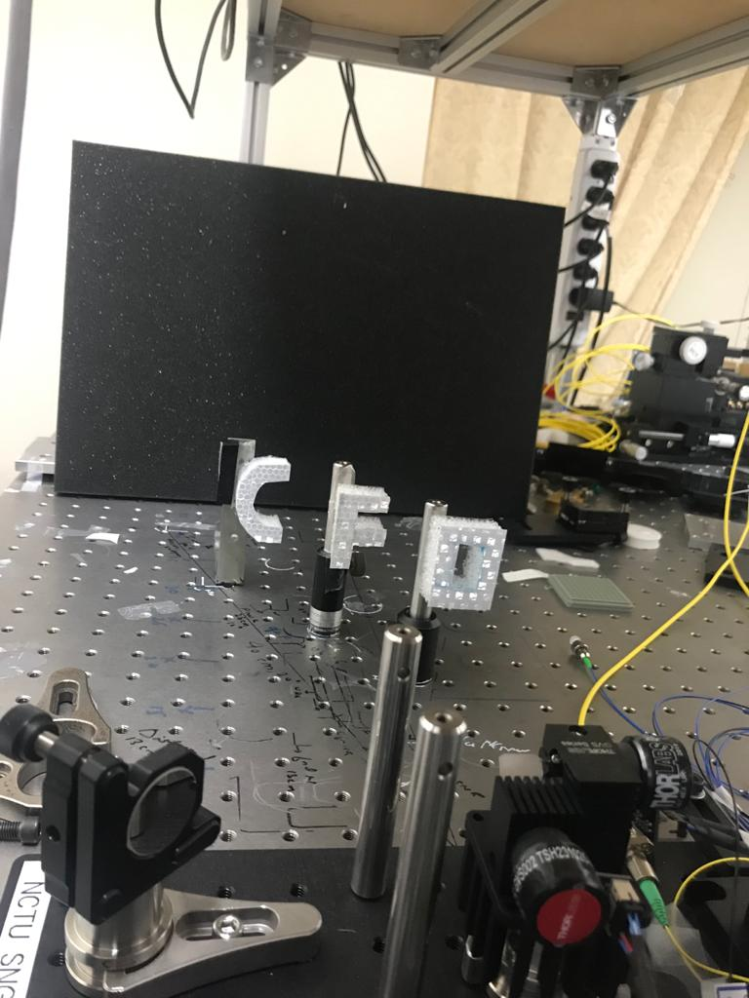
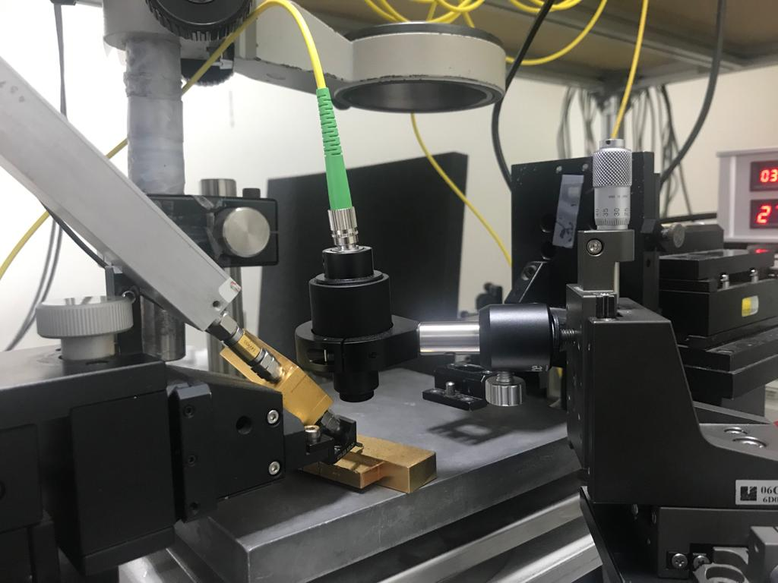
Captured Lidar Images
Background
LNA
Retroreflective tape Target
Target/OFC
5 cm
5 cm
25 Degree
FOV of Mirror
40 cm
Optical setup
APD (homemade)
Scan Mirror
30

Slide 31
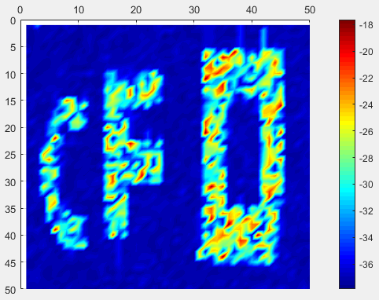
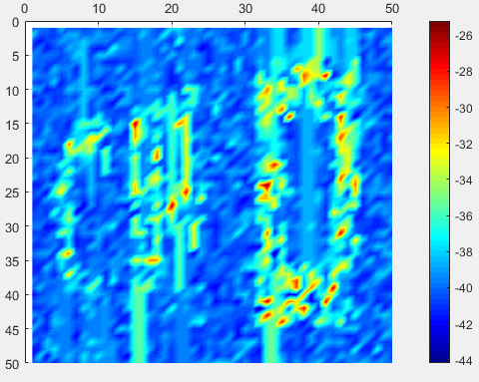
Captured Lidar Images
Pixels
Pixels
Pixels
Pixels
Power (dB)
Power (dB)
APD
p-i-n PD
APD has larger contrast ratio and Better Quality of Image!!

Slide 32
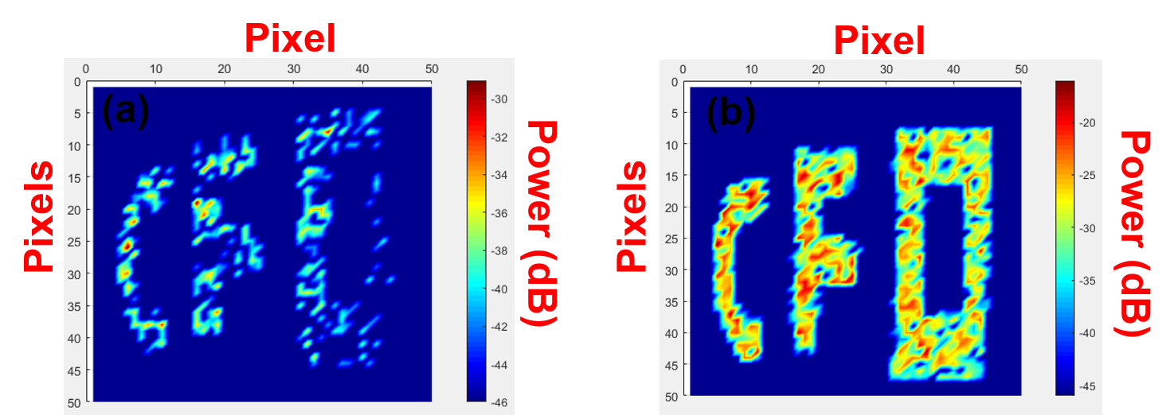
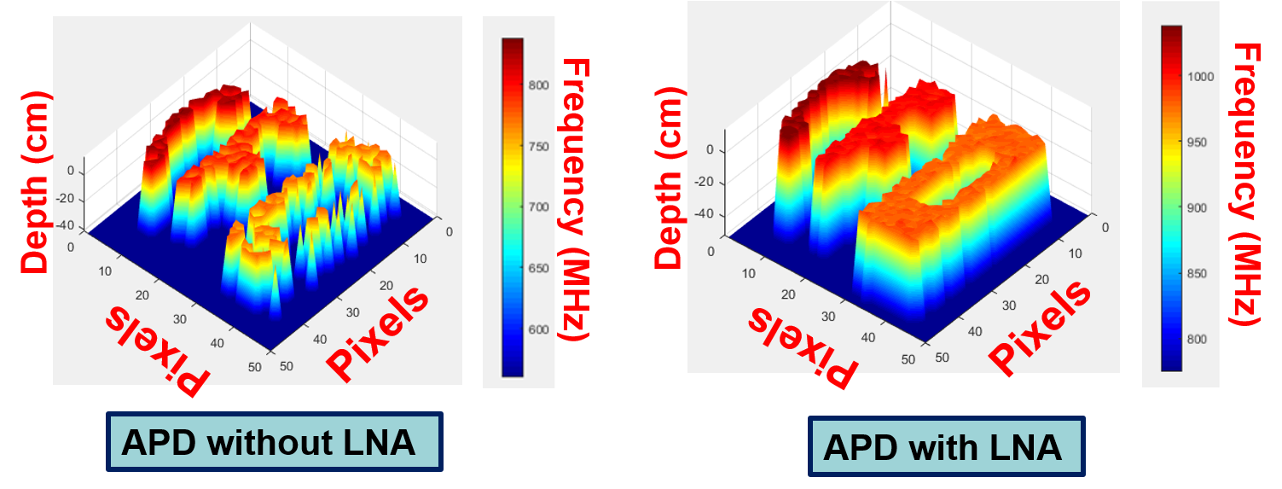
The captured lidar images
Both approaches can see clear Lidar image
Notes:
藉由每個像素(pixel)中所量測到的中頻訊號之頻率與深度訊息所建構之三維成像，我們可看到隨著3個字母距離不同，顏色會有落差，此代表著頻率的變化，距離越遠的目標物，頻率會越高。藉由觀察兩圖，我們發現兩種接收端的架設都可以讓我們獲取清楚的三維成像，其可歸功於我們累增崩潰光二極體高功率的優良表現。

Slide 33
Single Photon Detection measurement
Notes:
為了瞭解此解構在Geiger mode中的特性，我們用一樣的製程製作60um光窗大小的元件去探討元件的暗計術、單光子偵測效率與Afterpulsing的現象

Slide 34
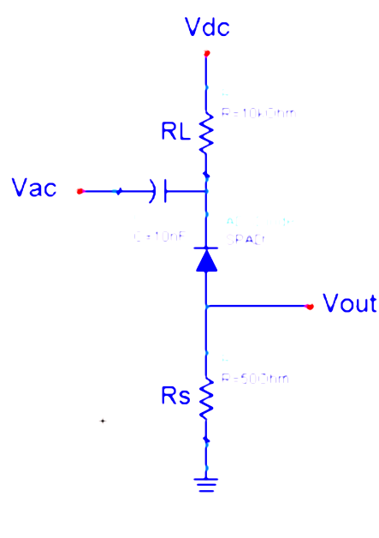
Quenching Circuit in Geiger mode
Besides avalanche signal ,it also show capacitively-coupled spurious signal in Vout
The trigger level was set to eliminate the capacitively-coupled spurious signal
The SPAD is operated under a gated mode with a passive quenching circuit
Notes:
因在Geiger mode中，我們的元件需要操作在崩潰電壓之上，當我們所施加電壓大於崩潰電壓時，SPAD會進入帶測狀態，只要元件接收到光子便會觸發崩潰產生崩潰饋電流，在此處產生的電流無法被內部載子復合的機制所截止，增益接近無窮大，大電流存在過久會對元件造成熱損壞，失去二極體特性，因此必須搭配外部截止電路，讓加在兩端的電壓低於崩潰電壓，使崩潰電流截止，經由偏壓衝電SPAD可再回到帶測狀態進行下一次偵測，而我們使用的是被動式截電路搭配Gate mode模式下操作 ，透過外部電壓閘控與大電阻同時對崩潰電流進行截止，保護元件。在這裡輸出波形包含兩種訊號，一種是電路中的電容耦合雜散訊號，另一種才是我們要量測的崩潰訊號，因此需要設定一個觸發檻值，且其值需要大於耦合訊號，以避免造成計數上的誤差。

Slide 35
DCR density(5ns)
The activation energy far less than
the half of energy bandgap of InGaAs & InAlAs
DCR is dominantly originated from the tunneling in the multiplication layer
DCR ↑ with temperature↓
Afterpulsing becomes serious
Operated with pulse width 5ns
DCR ↓ with temperature↓
Suppression thermal generation in InGaAs absorption layer
P+ Contact (In_{0.53}Ga_{0.47}As)
P+ Window (In_{0.53}Ga_{0.47}As)
P Graded Band(InAlGaAs)
i Absorber (In_{0.53}Ga_{0.47}As)
i Graded Band (InAlGaAs)
P Field Control (In_{0.52}Al_{0.48}As)
i Multiplication (In_{0.52}Al_{0.48}As)
P Field Control (In_{0.52}Al_{0.48}As)
i Multiplication (In_{0.52}Al_{0.48}As)
N Contact (In_{0.52}Al_{0.48}As)
N+ Contact(InP)
S.I.InP Substrate
Notes:
由圖我們可以看見透過將操作溫度降低，我們的暗計數可以下降，代表著在吸收層中熱產生的現象被壓制，而因為隨著溫度下降暗計數率也跟著降低。而通常溫度下降到一定數值時，暗計數又會增加， 原因在低溫時，通常會伴隨得嚴重的二次崩潰效應發生。為了瞭解暗計數的主要來源，我們去萃取元件的活化能，我們將暗計數率的自然對數對溫度的變化作圖取其斜率得到活化能，我們在低超額偏壓的條件下，對200K到300K這段溫度區間去作fittiing，萃取到的活化能為0.12ev，同時在在高超額偏壓下，對250到300K這段溫度區間作fitting，萃取到的活化能為0.05eV，期都遠低於InGaAs的吸收層與InAlAs的累增層能隙的一半，由此可知暗計數主要來源並非熱載子的產生複合所貢獻，而是來自高電場壘曾層中的穿隧電流。而根據先前的量測結果，我們在200K的時候有單光子偵測效率會有峰值出現，因此在接下來的量測中我們會以300K和200K兩種溫度去作數據的探討。

Slide 36
Afterpulsing Probability – pulse width
Narrow down the pulse width
Operated at 200K with pulse width 5ns
Operated at 200K with pulse width 1.5ns
P+ Contact (In_{0.53}Ga_{0.47}As)
P+ Window (In_{0.53}Ga_{0.47}As)
P Graded Band(InAlGaAs)
i Absorber (In_{0.53}Ga_{0.47}As)
i Graded Band (InAlGaAs)
narrower pulse decreases the amounts of carriers generated during an avalanche breakdown event, leading to less pronounced afterpulsing effect
P Field Control (In_{0.52}Al_{0.48}As)
i Multiplication (In_{0.52}Al_{0.48}As)
P Field Control (In_{0.52}Al_{0.48}As)
i Multiplication (In_{0.52}Al_{0.48}As)
N Contact (In_{0.52}Al_{0.48}As)
N+ Contact(InP)
S.I.InP Substrate
Notes:
因此為了有效避免後脈衝效應，我們將操作脈衝寬度從5ns縮到1.5ns，我們發現釋放載子所需要的推遲時間縮短，其原因為將操作元件的時間縮短，讓我們在崩潰時產生較少的電子電動對，因此被缺陷捕捉到的載子下降，讓我們可以有效抑制二次崩潰現象對元件造成影響。

Slide 37
Afterpulsing Probability (1.5ns)
The hold-off time required for minimal afterpulsing probability(1%) is 0.03 μs (33MHz)
Operated at 300K with pulse width 1.5ns
Operated at 200K with pulse width 1.5ns
Short hold-off time
→ afterpulsing effect can be eliminated with 10kHz gating frequency
P+ Contact (In_{0.53}Ga_{0.47}As)
P+ Window (In_{0.53}Ga_{0.47}As)
P Graded Band(InAlGaAs)
i Absorber (In_{0.53}Ga_{0.47}As)
i Graded Band (InAlGaAs)
0.022µs
0.028µs
0.028µs
0.03µs
P Field Control (In_{0.52}Al_{0.48}As)
i Multiplication (In_{0.52}Al_{0.48}As)
P Field Control (In_{0.52}Al_{0.48}As)
i Multiplication (In_{0.52}Al_{0.48}As)
N Contact (In_{0.52}Al_{0.48}As)
N+ Contact(InP)
S.I.InP Substrate
Notes:
透過在溫度200K和300K並以1.5ns的脈衝寬度去操作元件，我們可以發現為了得到最小的後脈衝效應發生機率，推遲時間必須控制在至少0.3us，將其換算成操作頻率為33MHz。此即為元件可以操作的最快速度，如此短的推移時間可以讓我們在10KHz的操作下去有效避開後脈衝效應對元件造成的技術誤差。

Slide 38
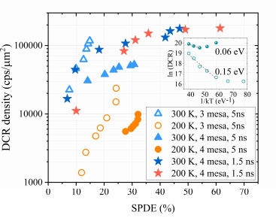
Comparison-DCR density versus SPDE
Device A(4 Mesa)
Device B(3 Mesa)
P+ Contact (In_{0.53}Ga_{0.47}As)
P+ Contact (In_{0.53}Ga_{0.47}As)
P+ Window (In_{0.53}Ga_{0.47}As)
P+ Window (In_{0.53}Ga_{0.47}As)
P Graded Band(InAlGaAs)
P Graded Band(InAlGaAs)
i Absorber (In_{0.53}Ga_{0.47}As)
i Absorber (In_{0.53}Ga_{0.47}As)
i Graded Band (InAlGaAs)
i Graded Band (InAlGaAs)
P Field Control (In_{0.52}Al_{0.48}As)
The SPDE is improved to 32 % and 31 % respectively for 200 K and 300 K due to the enhanced avalanche probability by incorporating a quadruple mesa structure
DCR for quadruple mesa device is several times lower compared to the triple mesa device at the same SPDE
P Field Control (In_{0.52}Al_{0.48}As)
i Multiplication (In_{0.52}Al_{0.48}As)
i Multiplication (In_{0.52}Al_{0.48}As)
P Field Control (In_{0.52}Al_{0.48}As)
P Field Control (In_{0.52}Al_{0.48}As)
i Multiplication (In_{0.52}Al_{0.48}As)
i Multiplication (In_{0.52}Al_{0.48}As)
N Contact (In_{0.52}Al_{0.48}As)
N Contact (In_{0.52}Al_{0.48}As)
N+ Contact(InP)
N+ Contact(InP)
S.I.InP Substrate
S.I.InP Substrate
Notes:
此圖我們將過去三個MESA的結構與四個MESA的結構做個比較。由圖可見，在5ns的脈衝寬度的操作下，其室溫與200K的單光子偵測效率的最高值分別從15%與24%成長到31%與32%。期可歸功於多一個MESA的設計，使我們的元件提供了更好的電場侷限效果，讓崩潰機率提升，進一步提升了單光子偵測效率。
此外，除了偵測效率外，因為有較好的電場侷限，讓我們的暗計數與之前相比亦下降許多。

Slide 39
SPDE & DCR at 200K &300K
Operated at 300K with pulse width 1.5ns
Operated at 200K with pulse width 1.5ns
177 kcps/μm2
180 kcps/μm2
SPDE 47 %
SPDE 61 %
Further improvement in M-layer should be taken into consideration in the future
High excess bias with narrower pulse width → serious tunneling effect
P+ Contact (In_{0.53}Ga_{0.47}As)
P+ Window (In_{0.53}Ga_{0.47}As)
P Graded Band(InAlGaAs)
maximum achievable SPDE reaches 61 % with 180
kcps/μm2 DCR at 200 K and 1.5ns pulse width
maximum achievable SPDE reaches 47 % with 177
kcps/μm2 at 300 K and 1.5ns pulse width
i Absorber (In_{0.53}Ga_{0.47}As)
i Graded Band (InAlGaAs)
P Field Control (In_{0.52}Al_{0.48}As)
i Multiplication (In_{0.52}Al_{0.48}As)
P Field Control (In_{0.52}Al_{0.48}As)
i Multiplication (In_{0.52}Al_{0.48}As)
N Contact (In_{0.52}Al_{0.48}As)
N+ Contact(InP)
S.I.InP Substrate
Notes:
兩圖分別顯示脈衝寬度1.5ns並且在200K和300K下所量測到的DCR和SPDE，在200K時，我們的元件可以擁有61.4%單光子偵測效率，而300K時則擁有47趴的SPDE，與過去提出的InAlAs based SPAD相比擁有相當優異的表現。而雖然SPDE上升，但是缺點是隨著超額偏壓的上升，內建電場上升，同時亦會讓穿隧現象變嚴重，進而導致我們的暗計數上升。透過比較兩圖，在相同脈衝寬度1.5ns，溫度300K與溫度200K兩種量測條件所得出之暗計數最大值分別為177 kcps/μm2 與180 kcps/μm2，暗計數落差不大，可以得知透過降溫的方式依然無法將暗計數壓下來，因此我們可以得出一個結論，在1.5ns的脈衝寬度操作下，暗計數主要被累增層中嚴重的穿隧現象所主導，而非吸收層中熱產生的現象。因此在未來的設計，我們我會希望可以在對累增層的設計上進行優化以改善暗計數的表現。

Slide 40
Timing Jitter(300K&200K)-FWHM
Lowest jitter 65 ps achieved with pulse width 1.5ns at room temperature
Operated at 300K & 200K
with pulse width 5ns
Operated at 300K &200K
with pulse width 1.5ns
P+ Contact (In_{0.53}Ga_{0.47}As)
P+ Window (In_{0.53}Ga_{0.47}As)
P Graded Band(InAlGaAs)
i Absorber (In_{0.53}Ga_{0.47}As)
i Graded Band (InAlGaAs)
With reducing the gate width and higher excess bias, the timing jitter is no further decreased due to the limitation of instrument response
P Field Control (In_{0.52}Al_{0.48}As)
Timing jitter universally decreases with increasing the excess bias
i Multiplication (In_{0.52}Al_{0.48}As)
P Field Control (In_{0.52}Al_{0.48}As)
i Multiplication (In_{0.52}Al_{0.48}As)
N Contact (In_{0.52}Al_{0.48}As)
N+ Contact(InP)
S.I.InP Substrate
Notes:
圖為脈衝寬度5ns與1.5ns的時基誤差量測結果，我們可以發現時機誤差會隨著偏壓上升而變小，其原因為隨著超額偏壓往上推，內建電場會變大，載子在元件內部移動的速度會變快，造成累曾延遲時間下降，進而降低時基誤差。我們由圖可以發現，而我們量測到最小的的時基誤差落在65ps，並且幾乎不存在擴散尾的現象。同時我們藉由比較兩張圖，最小的jitter數值差不多，分別為65ps和67ps，其原因為儀器響應的限制，使時機誤差無法隨著脈衝寬度縮小與偏壓加大進一步降低。

Slide 41
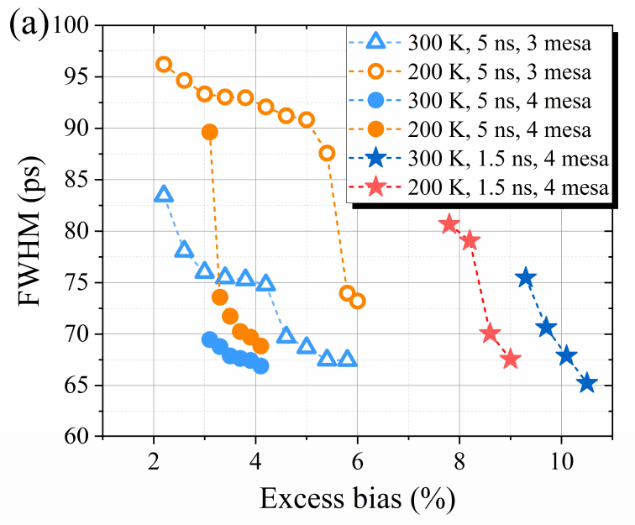
Comparison of Timing Jitter
Device A(4 Mesa)
Device B(3 Mesa)
P+ Contact (In_{0.53}Ga_{0.47}As)
P+ Contact (In_{0.53}Ga_{0.47}As)
P+ Window (In_{0.53}Ga_{0.47}As)
P+ Window (In_{0.53}Ga_{0.47}As)
P Graded Band(InAlGaAs)
P Graded Band(InAlGaAs)
i Absorber (In_{0.53}Ga_{0.47}As)
i Absorber (In_{0.53}Ga_{0.47}As)
i Graded Band (InAlGaAs)
i Graded Band (InAlGaAs)
P Field Control (In_{0.52}Al_{0.48}As)
Timing jitter can be greatly improved under the same excess bias by incorporating a quadruple mesa structure
P Field Control (In_{0.52}Al_{0.48}As)
i Multiplication (In_{0.52}Al_{0.48}As)
i Multiplication (In_{0.52}Al_{0.48}As)
P Field Control (In_{0.52}Al_{0.48}As)
P Field Control (In_{0.52}Al_{0.48}As)
i Multiplication (In_{0.52}Al_{0.48}As)
i Multiplication (In_{0.52}Al_{0.48}As)
N Contact (In_{0.52}Al_{0.48}As)
N Contact (In_{0.52}Al_{0.48}As)
N+ Contact(InP)
N+ Contact(InP)
S.I.InP Substrate
S.I.InP Substrate
Notes:
此圖為我們將過去三個MESA的結構與四個MESA的結構做個比較。由圖可見，在5ns的脈衝寬度的操作下，我們的時基誤差與之前的結構相比變小了，其可歸功於我們四個蝕刻平台的結構相較於之前的結構能更有效將電場侷限於元件中心，讓元件的速度表現得以提升

Slide 42
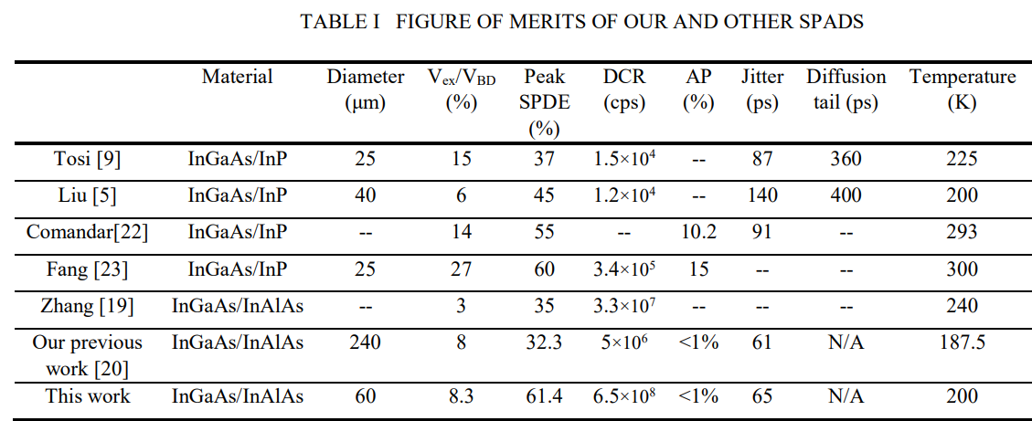
Recent achievements of InP/InAlAs based SPAD
P+ Contact (In_{0.53}Ga_{0.47}As)
P+ Window (In_{0.53}Ga_{0.47}As)
P Graded Band(InAlGaAs)
The SPDE reported in this work is better than the recent published results of InGaAs/InP SPAD
Low jitter & free from diffusion tail can also be reached in our device
i Absorber (In_{0.53}Ga_{0.47}As)
Further improvement :
Optimize the multiplication layer design to reduce the tunneling generation
i Graded Band (InAlGaAs)
P Field Control (In_{0.52}Al_{0.48}As)
i Multiplication (In_{0.52}Al_{0.48}As)
P Field Control (In_{0.52}Al_{0.48}As)
i Multiplication (In_{0.52}Al_{0.48}As)
N Contact (In_{0.52}Al_{0.48}As)
N+ Contact(InP)
S.I.InP Substrate
Notes:
這張是過去發表過用InGaAs當作吸收層材料的SPAD，我們可以發現我們的元件擁有相較其他元件較高的偵測效率、較低的時基誤差並且同時幾乎不存擴散尾的現象，其高性能都歸因於雙層累曾層與特殊的時刻平台型結構設計。但是缺點就是暗計數太高，因此在未來希望對壘曾層的設計上再做改良，以求降低壘曾層中的穿隧現象。

Slide 43
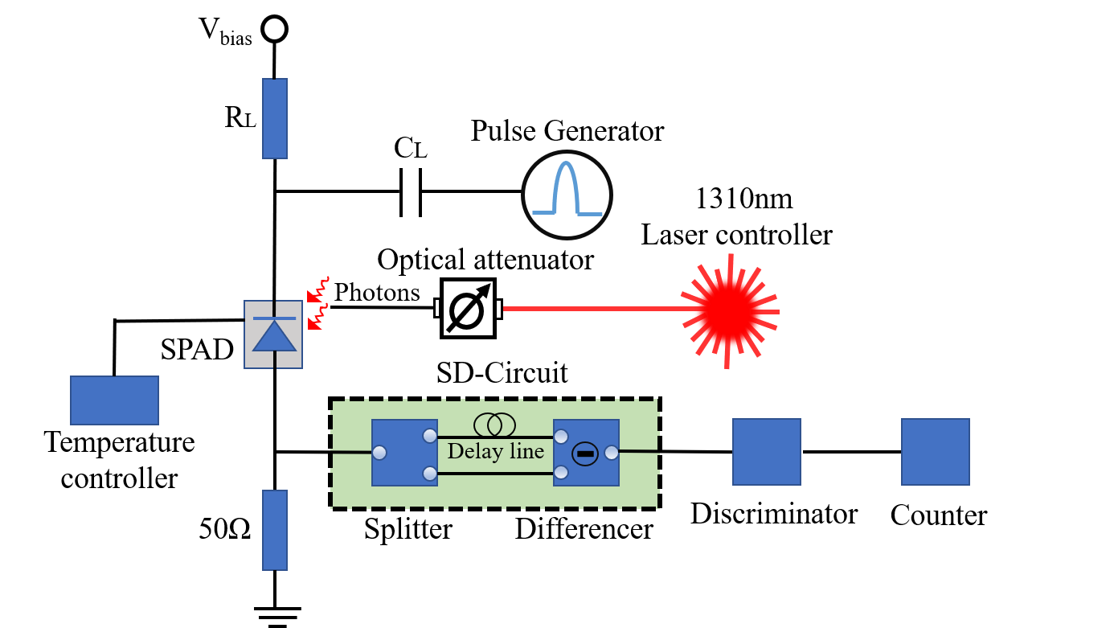
Extremely high efficiency
InGaAs/InAlAs SPAD
By incorporating SD circuits, our SPAD achieves superior SPDE performance of 74.3 % at 225 K.

Slide 44
Outline
Introduction and Motivation
Previous Arts
Our demonstrated dual M-layer structure
Measurement Results
Conclusion

Slide 45
Conclusion
We demonstrate novel top-illuminated APD structures with Dual M-layer design and special mesa structure.Such APDs can overcome the disadvantages which directly shrinking multiplication layer thickness
Such structures operated in linear mode with excellent high-power(+6.95 dBm) and high responsivity(6.3 A/W) performance which is desired for self-heterodyne FMCW lidar applications.
Such structures operated in Geiger mode with high detection efficiency(74.3%) of and low jitter(65ps) performance,which is desired especially for the ToF LiDAR.
Notes:
我們展示一種適合光達應用的正面收光累增崩潰光二極體，其製程簡單，並擁有良好的的性能，藉由雙層累增層的設計，讓我們可以抑制直接縮薄累增層所帶來的劣勢，同時透過四個蝕刻平台的結構設計，為我們的元件提供更好的電場侷限效果。作為FMCW光達接收端，在高功率操作下，其相較於P-I-N二極體更大的RF輸出功率(+6.95dBm v.s -3.5dBm)、更高的響應度(6.3 A/W v.s 1 A/W)與相近之飽和電流，作為ToF光達接收端，我們擁有相較於過去發表之單光子偵測器更高的單光子偵測效率(~61.4%)與更低的時基誤差(65ps) ，為未來光學雷達系統的接收端開闢了新的途徑。

Slide 46
Thank you

